Slide 1

Sequence Diagrams
Notes:
‹#›

Slide 2
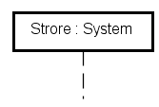
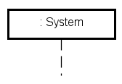
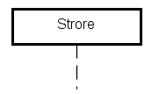
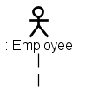
Notation Used For Sequence Diagrams
Lifeline boxes represent the interacting objects:
named object of a given class (default)
anonymous object of a given class
object without class
actor
Store
Store

Slide 3
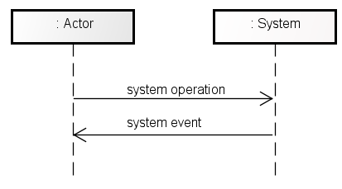
Modeling Actor-System Interactions
Lifeline box (actor)
Lifeline box (system)
Operation (message)
Lifeline
Temporal ordering
Event (message)

Slide 4
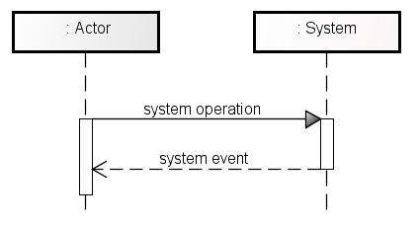
Synchronous VS Asynchronous
Synchronous communication
Asynchronous communication
Sender waits for response
Sender continues
Be aware - most tools use their own syntax or appearance for these diagrams. So, don’t worry about making your sequence diagrams from having the exact same appearance. Instead, focus on the content and concepts of your diagrams.

Slide 5
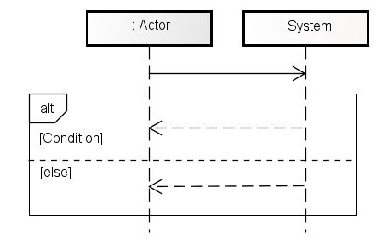
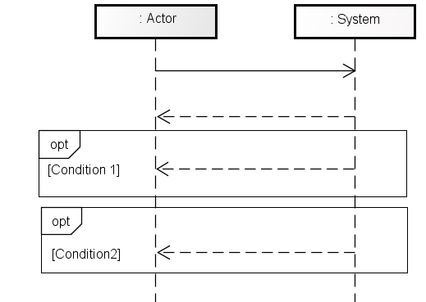
Representing Choices
Alternative
Options
two alternative possible responses (depending on condition)
two possible responses (depending on conditions)

Slide 6
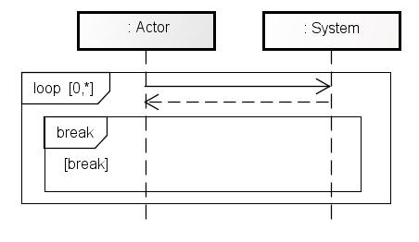
Representing Loops
Loops/Repetition
Operation is requested repeatedly

Slide 7
Level of Detail
For user interaction with system (often in analysis phase)
Who does what to start what?
Show all of their responsibilities
For object communication, creation, destruction (used in design phase)
Shows lifetime of objects
Shows communication (synchron, ansynchron)

Slide 8
When Should We Use These?
Sequence diagrams can be used to model the scenarios contained in some use cases:
Communication between actor and system
System operations (i.e. user requests)
System events (i.e. system responses)
Sequential ordering of operations and events

Slide 9
Example Diagrams
Notes:
‹#›

Slide 10
Preface
Different approaches on how to use Use Cases, Sequence Diagrams and Activity Diagrams
Some general advice:
UC:
UC at a high level of abstraction for Analysis
Define Use Cases in your documentation
Define which Scenarios are included in a Use Case
SD:
You should use them at a high level of abstraction for Actor-System communication
Create 1 SD for each Scenario in a Use Case
AD:
Use 1 Activity diagram for each Actor-Use-Case Interaction
Includes all Scenarios and sets them in context
So, for a Use Case where the user interacts with the system N times, and contains X scenarios, you would have N activity diagrams and X Sequence Diagrams.

Slide 11
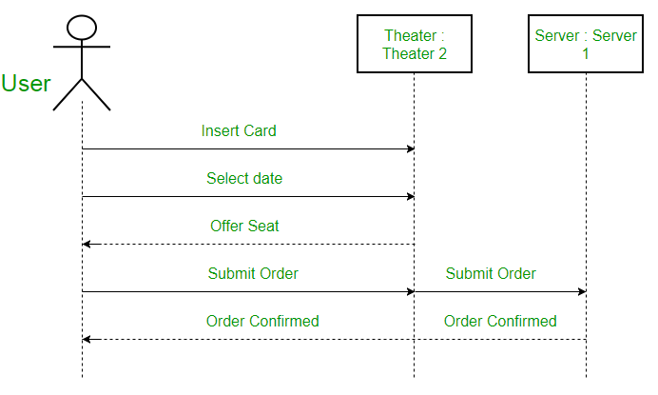
Example 1 - Multiple User Interactions
From: https://www.geeksforgeeks.org/unified-modeling-language-uml-sequence-diagrams/#

Slide 12
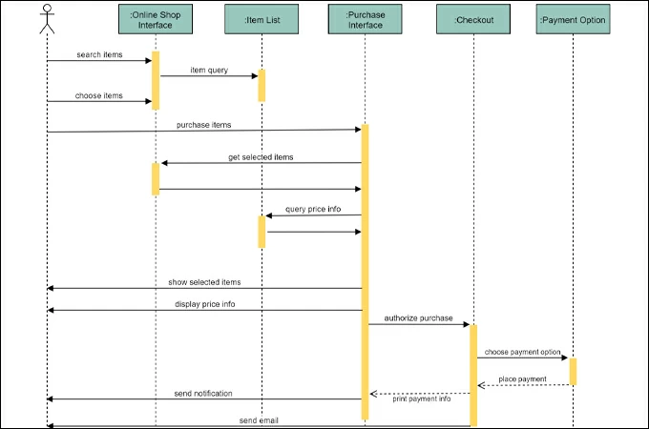
Example 2 - More Complex System
From: https://gitmind.com/sequence-diagram-example.html

Slide 13
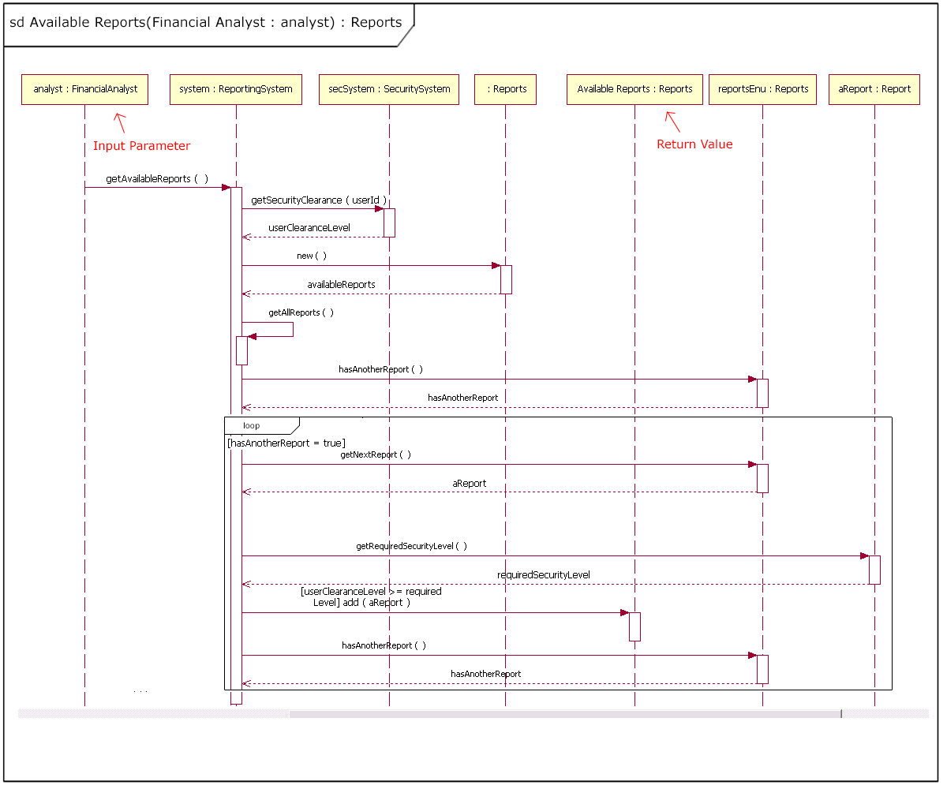
Example 3 - System with a Loop
From: https://developer.ibm.com/articles/the-sequence-diagram/

Slide 14
Wrap Up
We’ve now looked at all three common types of diagrams
Use Cases
Activity Diagrams
Sequence Diagrams
You should now be able to see how they all relate to each other
ADs and SDs are essentially expansions on parts of UCs
How often are you going to use all of these diagrams?
Of course, it depends on your team/project/company/etc.
You don’t have to use all of them
A few things to ask yourself:
Where is the risk?
Where is the complexity?
Does X type of diagram make sense for this problem?
Don’t get lost in diagram land
You make a diagram, great, you’ve got a diagram, but no code
The diagram should be something to make that code easier to write!

